Slide 1
TITLE-I SPRING INPUT MEETING
L.P. Miles Elementary
Tuesday, February 6, 2024
4:00 p.m.

Slide 2
WHAT IS TITLE I?
It’s the largest federal aid program for public schools in the United States. Title I is designed to support State and local school reform efforts tied to the challenging State academic standards for improving teaching and learning for students. Title I programs must be based on effective means of improving student achievement and include strategies to support parent and family engagement.
Notes:
This is where you will share a definition of Title I.

Slide 3
WHAT IS PARENT AND FAMILY ENGAGEMENT?
Parent and Family Engagement is an ongoing process that increases active participation, communication, and collaboration between parents, schools, and communities with the goal of educating the whole child to ensure student achievement and success.
School Parent and Family Engagement Plan
School-Parent Compact
School compacts and plans will be distributed to L.P. Miles families online throughout the school year.
School compacts and plans are jointly updated annually with all school community input.
Notes:
This is where you will share a definition of Title I.

Slide 4
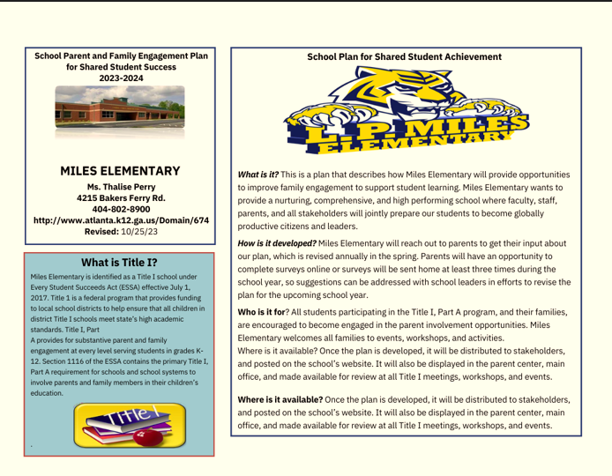
PARENT & FAMILY ENGAGEMENT PLAN
The plan establishes the school’s expectations for parent and family engagement and describes how our school will implement a number of specific parent and family engagement activities, and it is incorporated into the school’s plan submitted to the local educational agency (LEA).
Notes:
This is where you will share a definition of Title I.

Slide 5
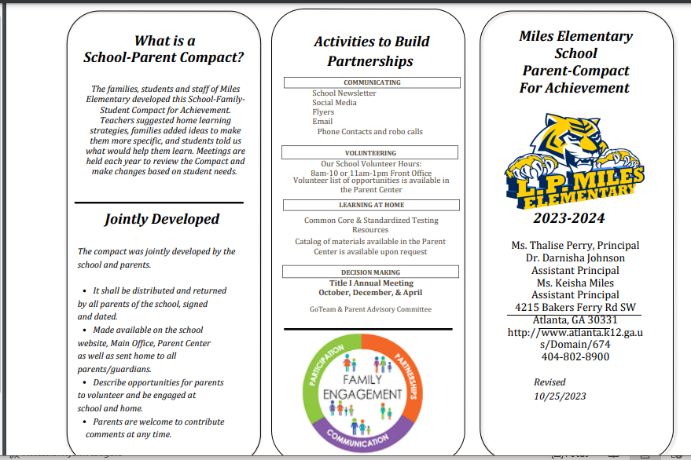
SCHOOL-PARENT COMPACT
School Parent Compact outlines how the parents, the entire school staff, and the students will share the responsibility for improved student academic achievement as well as describes how the school and parents will build and develop a partnership that will help children achieve the State’s high standards.
Notes:
This is where you will share a definition of Title I.

Slide 6
Building Staff Capacity
Training for school staff on how to communicate with and engage parents & families as equal partners in the education of their children
How we build school staff capacity:
Value parent contribution
Communicate effectively with parents
Work with parents as equal partners
Build Ties between the parents and the school

Slide 7
LET’S GET SOME FEEDBACK!
Now that we have recapped, please complete our title I parent and family engagement survey. Your responses will be used to make updates to the 2024- 2025 title I family engagement plan and school-parent compact.

Slide 8
THANK YOU

